Slide 2
Titanic - Machine Learning from Disaster
Presented by
Naveena Kanderi - nkanderi@kent.edu
Vaishnavi Valluri - vvalluri@kent.edu
Jashwanth Reddy Baggari - jbaggari@kent.edu
Sandeep Narayanasetty - snaraya5@kent.edu

Slide 3
Overview
Introduction
Project Objectives
Potential Customers & End Users
Stakeholder & Constraints imposed
Assumptions and Risks
Tools Utilized
Literature Review
Data Cleaning
Data Analysis
Methods Implemented
Results

Slide 4
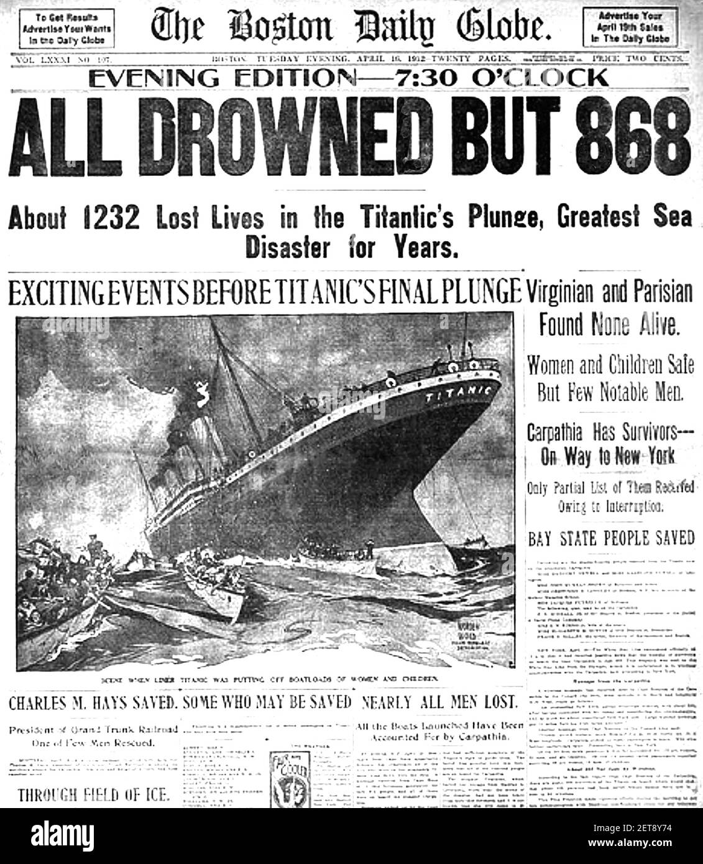
INTRODUCTION`
Although it has been many years since Titanic disaster took place, research on understanding what impacts individual’s survival or death has been attracting researchers' attention.So, we are going to study the dataset and get results from the raw and missing data by using machine learning techniques.

Slide 5
Project Objectives
To build a predictive model that helps us to get the probability of survival for the passengers that boarded the Legendary Titanic Ship.
Implement this predictive model for any disaster that might happen in future.
Get insights on various algorithms used in Machine learning techniques.
To get familiar working with large datasets, processing the data, data cleaning, training of datasets, visualization of the data and predicting the possible outcomes.

Slide 6
Potential Customers
Any Government organizations, travel agencies or any institutions that organize large events involving any potential risks to the lives of people that use their services.
End Users
Authorized personnel that handle Disaster Management in fields such as Police, Fire, Medical etc.

Slide 7
Stakeholder
Srinadh B
Application Development Manager at CVS Health Corporation
Email ID: bssrinadh@gmail.com
Constraints Imposed by the Customer
Obtained results shall be displayed to end users in the form of graphs so they can be easily understood.
Use the Box plots and density plots to visualize the probability of survival for various constraints.
Choose the most suitable patterns of correlation to predict your results.

Slide 8
Assumptions and Risks
When features that have less correlation are selected to train the data over the ones that might provide higher correlation, it could possibly predict the result with less accuracy.
Additional data such as differentiating the crew from passengers might help us to train the data with more accuracy.
Care should be taken while replacing missing values in the dataset as considering improper values might lead to less accurate results.
We should be cautious while adding more data to the dataset, as it might predict incorrect results.
While neglecting data from a given dataset, care should be taken not to omit data that might be relevant in producing results of higher accuracy.

Slide 9
Tools Utilized
Numpy
Pandas
Seaborn
Matplot
Scikit -learn
Jupyter notebook

Slide 10
LITERATURE REVIEW
Paper 1: Titanic: Statistical Analytics from Disaster
Link:http://ijeais.org/wp-content/uploads/2020/10/IJAER201007.pdf
Paper 2: A Comparative Study on Machine Learning Techniques using Titanic Dataset
Link:https://www.researchgate.net/publication/324909545_A_Comparative_Study_on_Machine_Learning_Techniques_Using_Titanic_Dataset

Slide 11
DATA PREPROCESSING

Slide 12
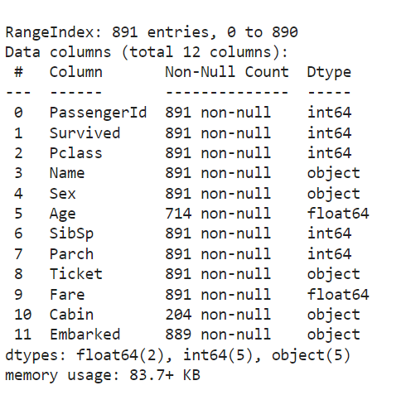
DATA SET
Source: Kaggle website
Datasets:
Training Dataset
— 891 samples of data
— 12 unique features
Test Dataset
— 418 samples
—11 unique features

Slide 13
Data Features
PassengerID: It is a numerical feature which represents the number of passengers and it is used to just sort the dataset. So we can drop the dataset.
PClass: The feature PClass is given as a number but we can use it as a category. By using this feature, we can categorize the passenger from the wealthiest classes to other classes.
Name: We can extract the titles of the passenger like Mr., Mrs., Miss, Master. We can use the extracted title for filling the missing values in another feature as AGE.
SibSp and Parch: used to group the families together.

Slide 14
Age: highly relevant, but has 177 null values. can fill those null values using mean or median or by the title of the passenger.
Ticket: has no pattern to parse so we can drop this row.
Cabin: Shows us which cabin is booked by the passenger, as there 687 null values from 891 sample data we have. We have used 0 & 1 to see if cabin is available or not.
Embarked: This is considered as a string feature. We have three ports where people have boarded the titanic, we have only 2 missing values in this feature. We can either drop those two rows from the dataset or we can fill it with S as in the dataset the most number of people embarked at Southampton.
Sex: We can label male as 0 and female as 1.

Slide 15
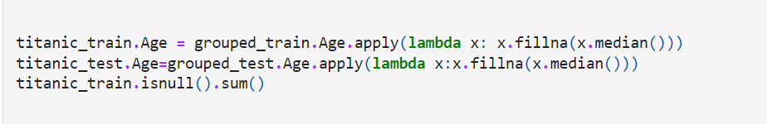
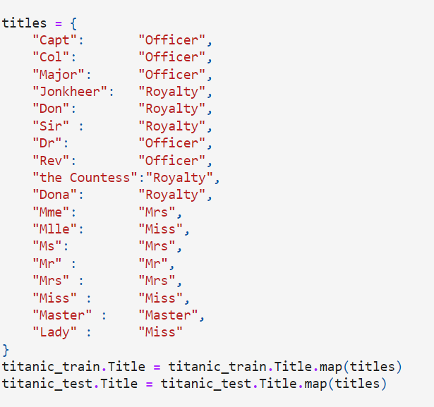
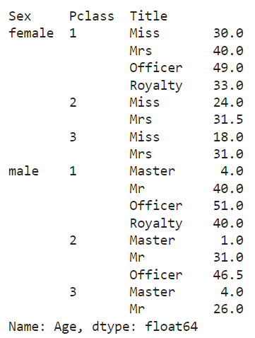

Slide 16
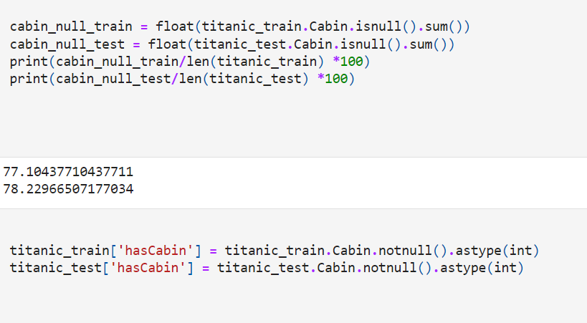

Slide 17
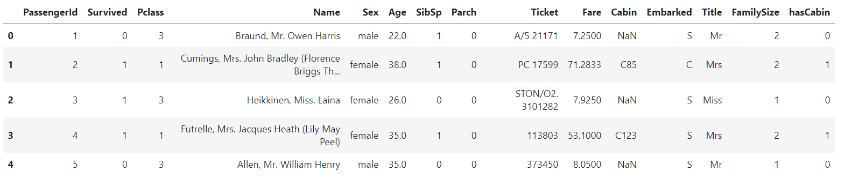
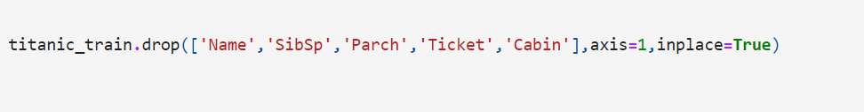
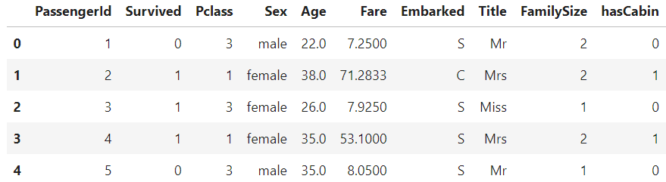

Slide 18
DATA ANALYSIS

Slide 19
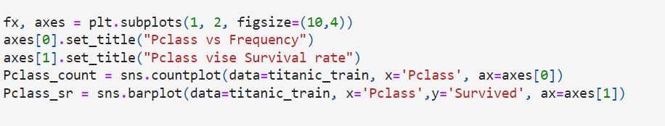
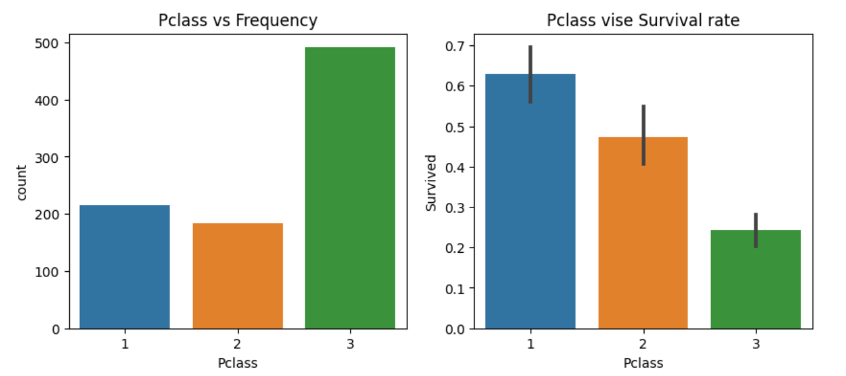

Slide 20
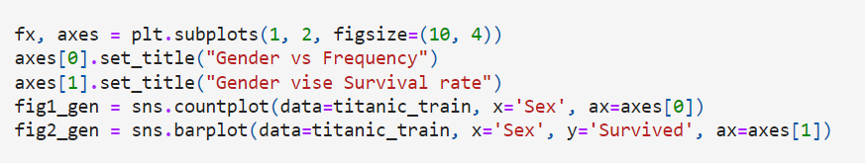
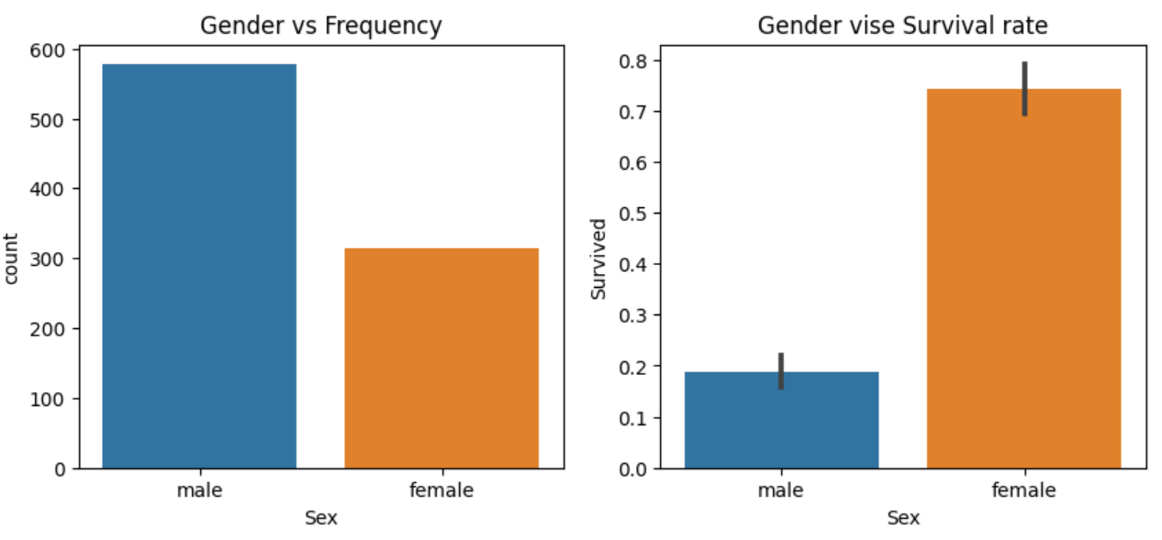

Slide 21
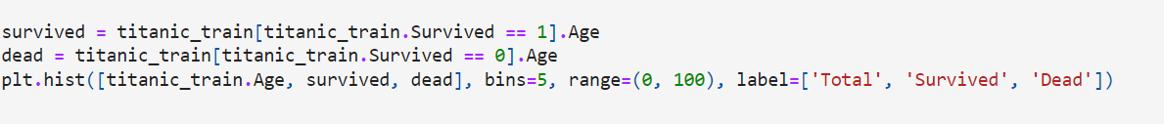
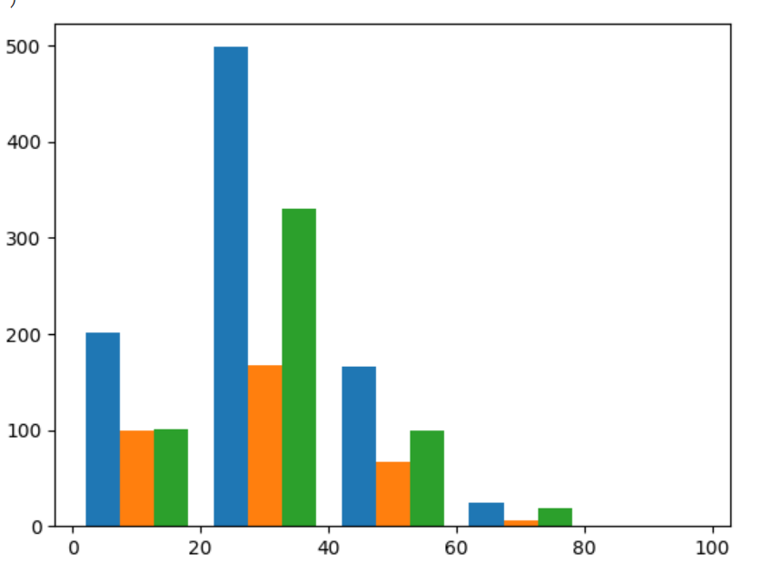
Total,Survived,Dead
AGE

Slide 22
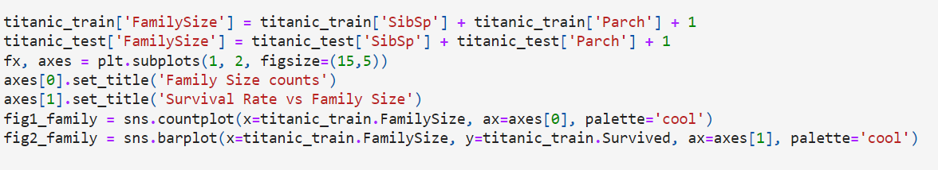
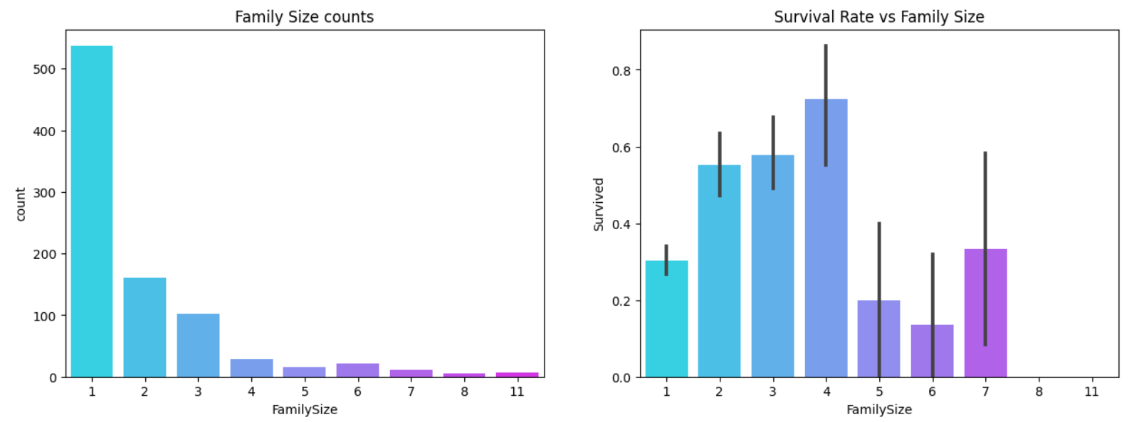

Slide 23
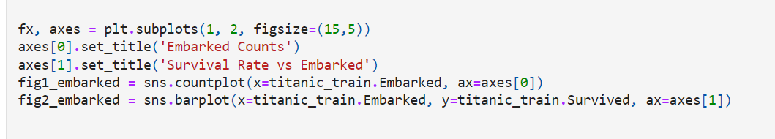
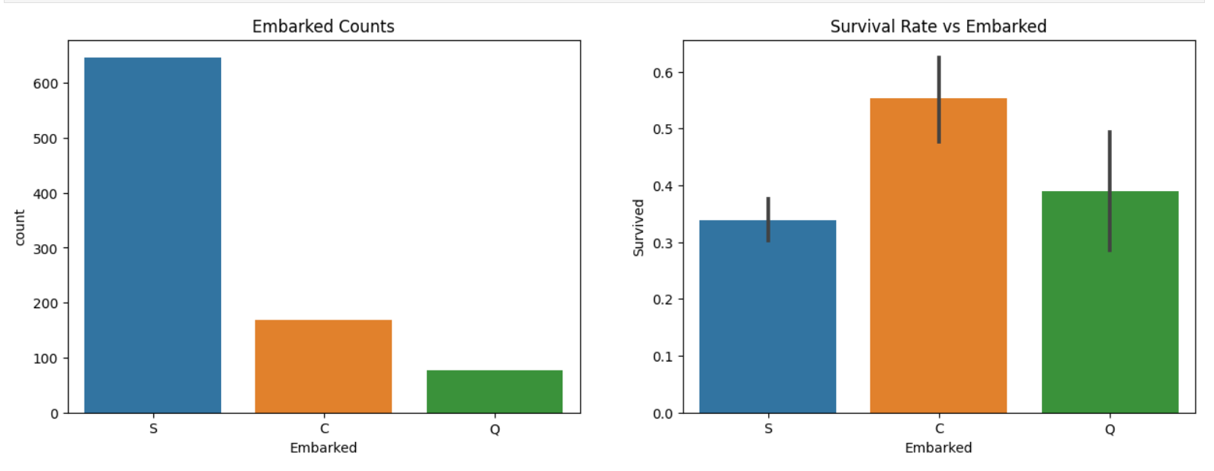

Slide 24
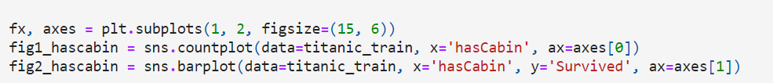
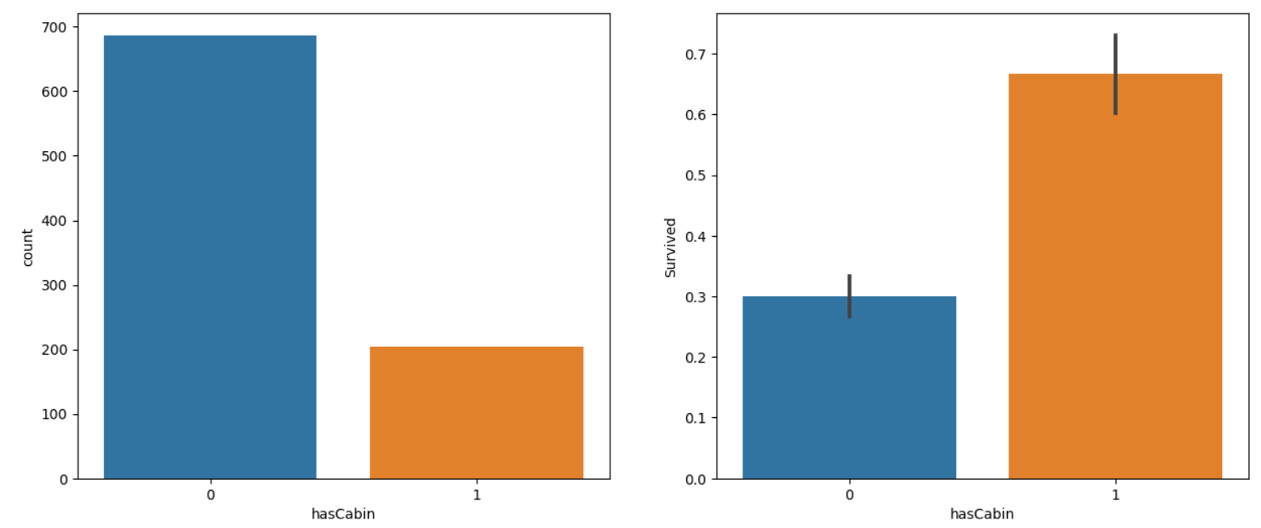

Slide 25
METHODS EMPLOYED
RESULTS

Slide 26
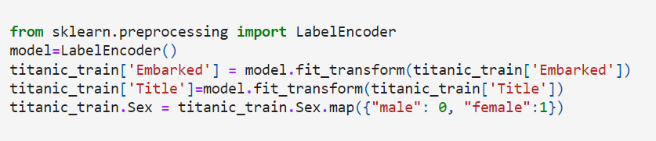
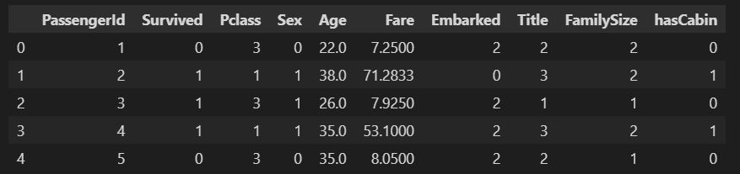

Slide 27
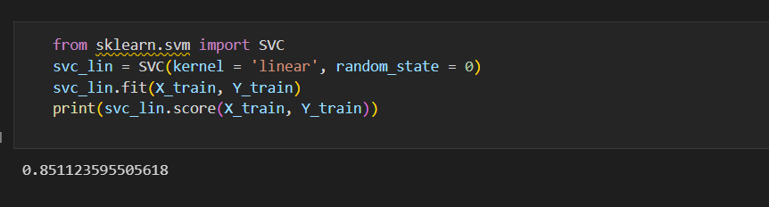
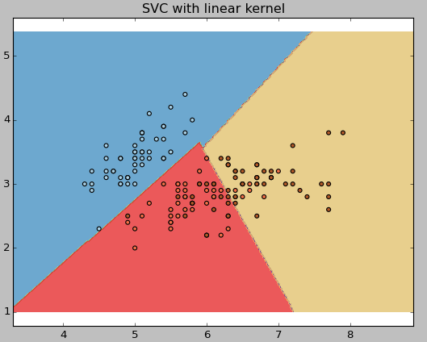
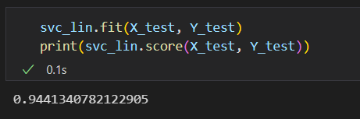
SVM

Slide 28
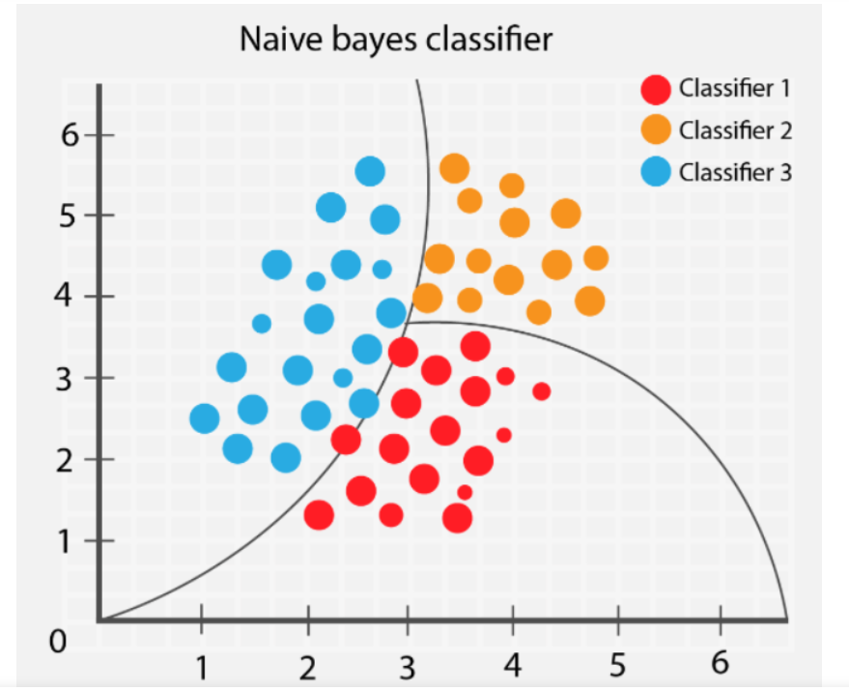
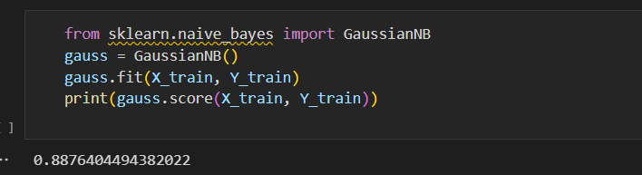
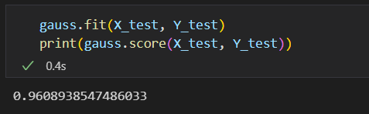
Gaussian Naïve Bayes

Slide 29
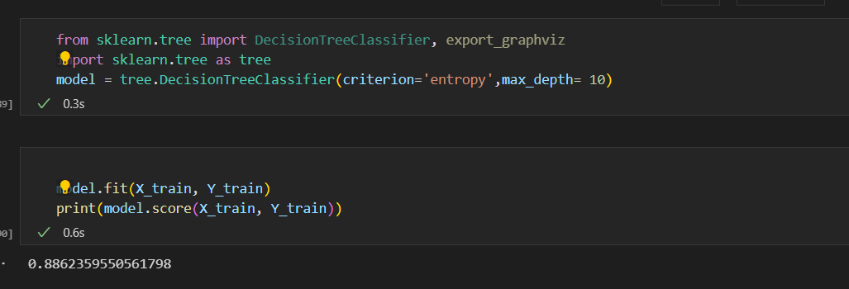
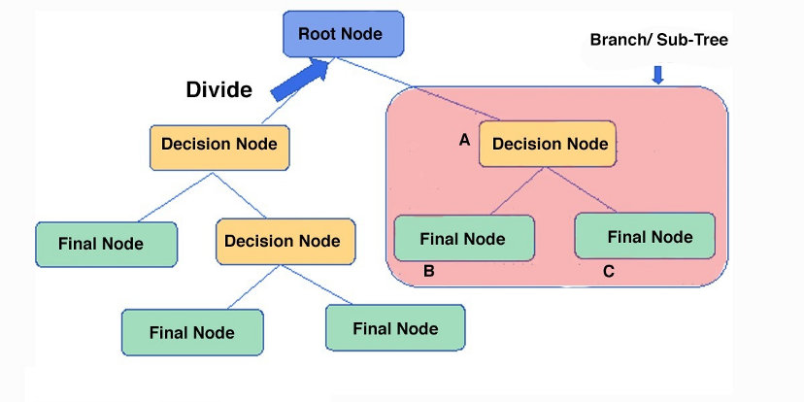
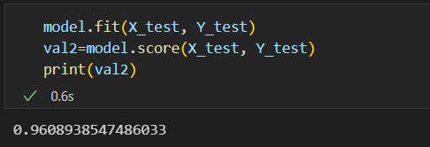
DECISION TREES

Slide 30
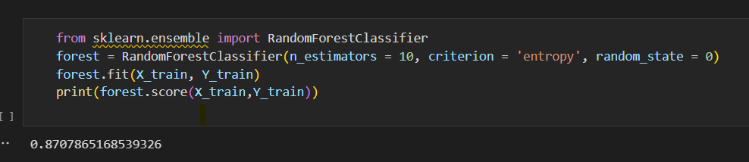
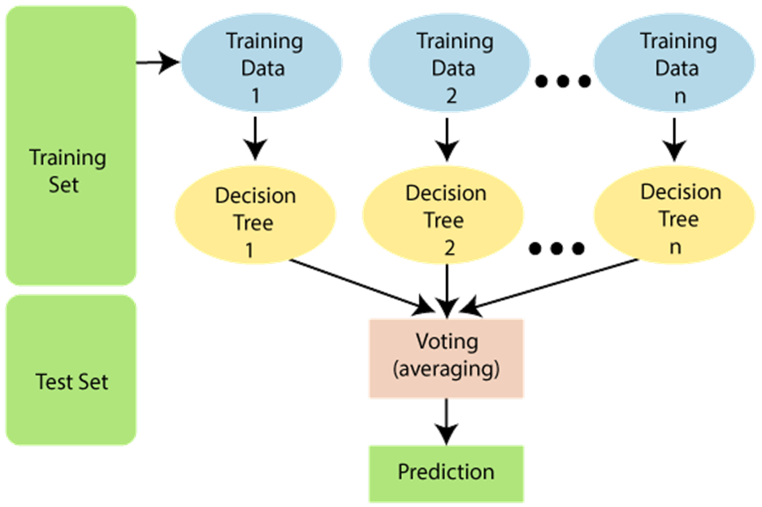
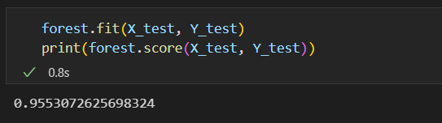
Random Forest

Slide 31
RESULTS
Method | Train | Test
SVM Linear | 0.851 | 0.944
Gaussian NB | 0.868 | 0.960
Random Forest | 0.870 | 0.955
Decision Tree | 0.886 | 0.960

Slide 32
THANK YOU

